Slide 1
Data Science Basics in R:
Day 4: R in the “Real World”

Slide 2
Goals for today

Slide 3
Version control with github

Slide 4
Version control

Slide 5
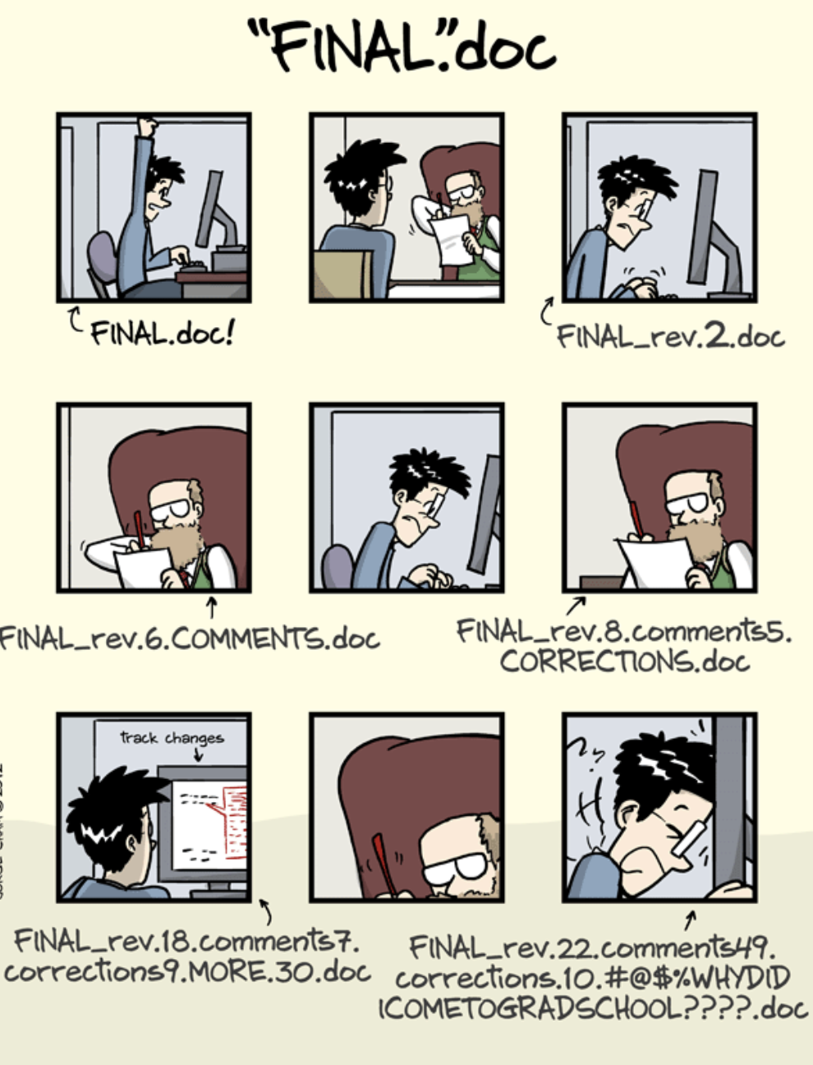
PHD comics

Slide 6
Github

Slide 7
Creating a github account

Slide 8
Research and open-source projects in R

Slide 9
Where to learn more

Slide 10
How to get good at R
(or python, or SQL, github, or…)
Use R, and use it often
Use R when you could use Excel, even if it takes longer
Consider a fun personal project
Follow others on github and check out what they’re doing

Slide 11
Thank you!
Please stay in touch.
Lecture and course material adapted from Intro to R materials created by Alex Douglas, available online here, with corresponding free online textbook.

